Slide 1


welcome

Slide 2

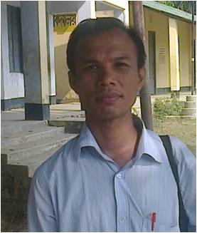
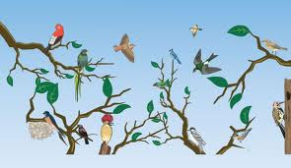
Biplab Bikash Tripura
Assistant Teacher
Taitong para Govt. Primary School
Rajasthali,Rangamati.
E-mail:bbtripura@gmail.com

Slide 3
Class:Three
Subject:English
Time:40min

Slide 4

Look at the video

Slide 5

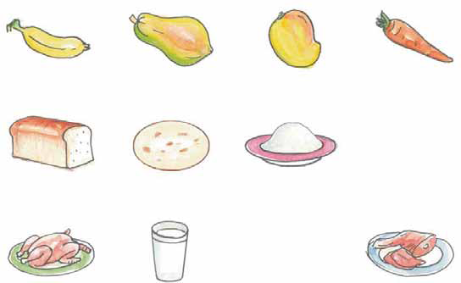
Look at the picture and think

Slide 6
Unit11:
Food and hygiene
Lesson
Food we need.

Slide 7

Learning outcomes
Students will be able…..
to read the sentences with correct pronunciation.
to use new words.
to know food from plants, trees and animals.

Slide 8

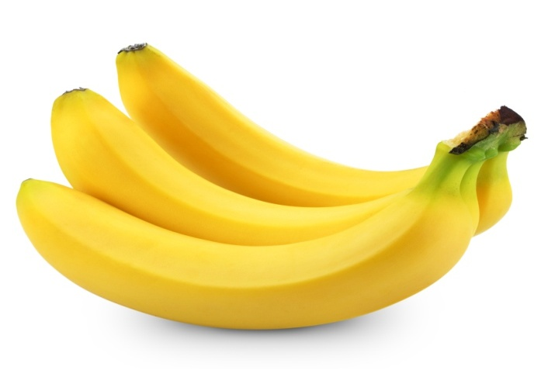
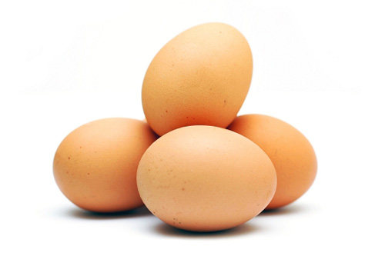
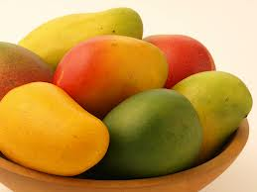
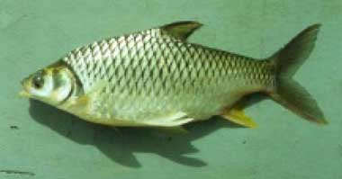
Look at the picture
Banana
Egg
Mango
Fish

Slide 9

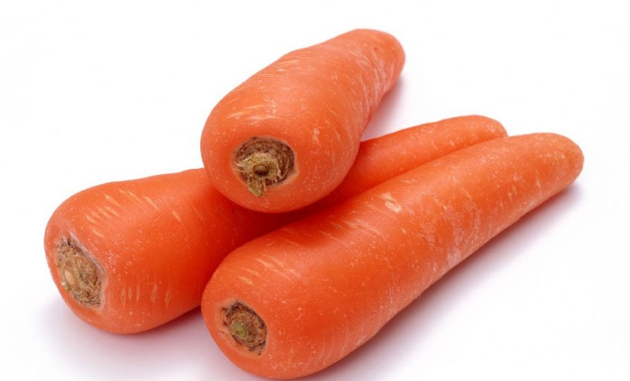
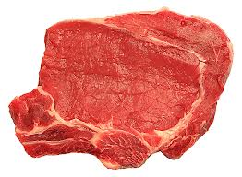
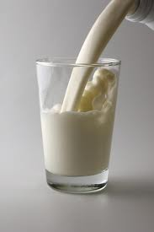
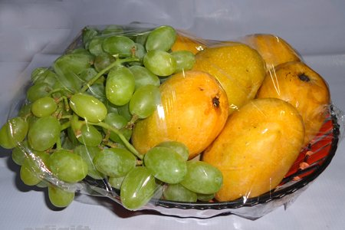
Look at the picture
Carrot
Meat
Milk
Fruits

Slide 10

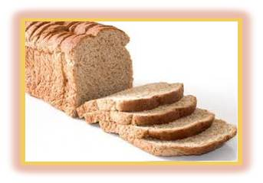
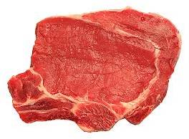
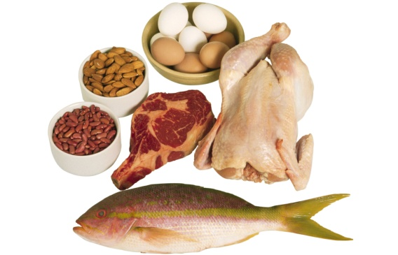
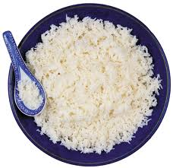
Look at the picture
Meat
Loaf of bread
Chicken
Rice

Slide 11
Open your book at page no 74

Slide 12
Teacher’s reading
Student’s reading

Slide 13
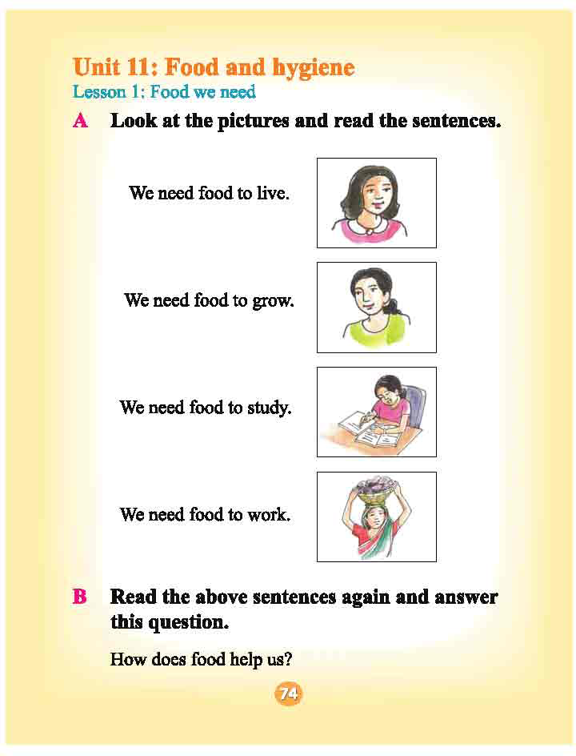
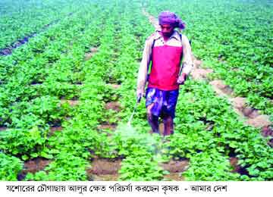
New words
Study
Milk
Work
Food

Slide 14

Group work
Lily group
Write five food names that we get from plants and trees.
Sun flower group
Write five food names that we get from animals.

Slide 15
Question and Answer
Which food we get form animals?
b)How many types of food we can see the text?
c)Which food we get form plants?

Slide 16

Home Task
You can add more foods name which we get from plants, trees and animals.

Slide 17

Thank’s to all
See you again.

